Slide 1


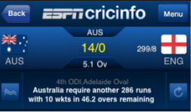

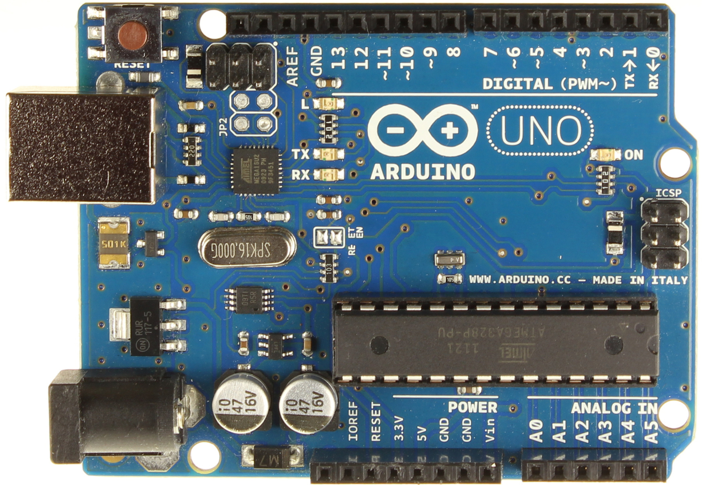
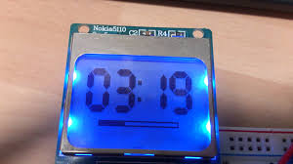
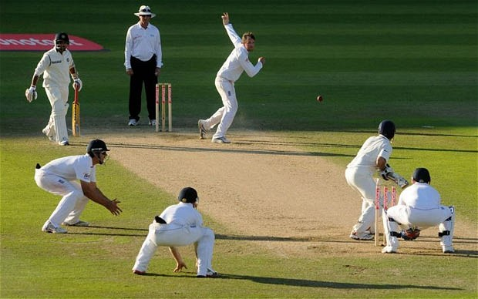
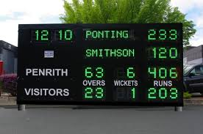
hhhhhhhhhhhhh
Cricket Scoreboard
Bluetooth
Data base Server
Scoreboard Input Mobile App
Adruino via Bluetooth
Arduino
User App
LCD Scoreboard
Cricket Match

